Slide 1
Dr. Siddhartha Agarwal MND 404 Chapter 1
Introduction to Mine Systems Engg.

Slide 2
Class Policy & Syllabus
2 Sessional
1 Midterm
1 FINAL
Grading is relative
In Class Surprise Quizzes can be used to make up for sessional
39 lectures

Slide 3
Questions that we will Answer
What is Systems Engineering ?
What is Operations Research ?
What is optimization ?
What are convex/concave sets ?
What is Linear optimization ?
What is non-linear optimization ?
How is Systems Engineering connected to OR ?

Slide 4
application of optimization in Mining
Ultimate Pit decision ( CAMPAD)
Block Sequencing and extraction in Open and UG mine planning
Coal transportation
Minimization of Energy consumption in mines
First Mile Connectivity
Under Loading Overloading of Wagons
Ore Grade Control
Maximize Productivity

Slide 5
Introduction
Operations Research is an Art and Science
It had its early roots in World War II and is flourishing in business and industry with the aid of computer
Primary applications areas of Operations Research include forecasting, production scheduling, inventory control, capital budgeting, and transportation.

Slide 6
What is Operations Research?
Operations
The activities carried out in an organization.
Research
The process of observation and testing characterized by the scientific method. Situation, problem statement, model construction, validation, experimentation, candidate solutions.
Operations Research is a quantitative approach to decision making based on the scientific method of problem solving.

Slide 7
What is Operations Research?
Operations Research is the scientific approach to execute decision making, which consists of:
The art of mathematical modeling of complex situations
The science of the development of solution techniques used to solve these models
The ability to effectively communicate the results to the decision maker

Slide 8
What Do We do
OR professionals aim to provide rational bases for decision making by seeking to understand and structure complex situations and to use this understanding to predict system behavior and improve system performance.
Much of this work is done using analytical and numerical techniques to develop and manipulate mathematical and computer models of organizational systems composed of people, machines, and procedures.

Slide 9
Terminology
The British/Europeans refer to “Operational Research", the Americans to “Operations Research" - but both are often shortened to just "OR".
Another term used for this field is “Management Science" ("MS"). In U.S. OR and MS are combined together to form "OR/MS" or "ORMS".
Yet other terms sometimes used are “Industrial Engineering" ("IE") and “Decision Science" ("DS").

Slide 10
History of OR
OR is a relatively new discipline.
70 years ago it would have been possible to study mathematics, physics or engineering at university it would not have been possible to study OR.
It was really only in the late 1930's that operationas research began in a systematic way.

Slide 11
1890
Frederick Taylor
Scientific Management
[Industrial Engineering]
1900
Henry Gannt
[Project Scheduling]
Andrey A. Markov
[Markov Processes]
Assignment
[Networks]
1910
F. W. Harris
[Inventory Theory]
E. K. Erlang
[Queuing Theory]
1920
William Shewart
[Control Charts]
H.Dodge – H.Roming
[Quality Theory]
1960
John D.C. Litle
[Queuing Theory]
Simscript - GPSS
[Simulation]
1950
H.Kuhn - A.Tucker
[Non-Linear Prog.]
Ralph Gomory
[Integer Prog.]
PERT/CPM
Richard Bellman
[Dynamic Prog.]
ORSA and TIMS
1940
World War 2
George Dantzig
[Linear Programming]
First Computer
1930
Jon Von Neuman – Oscar Morgenstern
[Game Theory]
1970
Microcomputer
1980
H. Karmarkar
[Linear Prog.]
Personal computer
OR/MS Softwares
1990
Spreadsheet Packages
INFORMS
2022
You are here

Slide 12
Operations Research Models
Deterministic Models Stochastic Models
• Linear Programming • Discrete-Time Markov Chains
• Network Optimization • Continuous-Time Markov Chains
• Integer Programming • Queuing Theory (waiting lines)
• Nonlinear Programming • Decision Analysis
Inventory Models Game Theory
Inventory models
Simulation

Slide 13
Deterministic vs. Stochastic Models
Deterministic models
assume all data are known with certainty
Stochastic models
explicitly represent uncertain data via
random variables or stochastic processes.
Deterministic models involve optimization
Stochastic models
characterize / estimate system performance.

Slide 14
Operations Research in Engineering Industry
All industries face the same challenge: how to use advances in technology to increase their productivity and reduce waste. As a result, the focus of technological development is on optimization. On the other hand, each industry faces its own unique variations on this challenge, and success lies in overcoming them in the best possible way.
Strategic mine planning and optimization throughout all lifecycle stages are essential for miners' competitiveness

Slide 15
Quants: The Rocket Scientists of Wall Street

Slide 16
Quantitative finance
Computational Finance: Computational methods, including Monte Carlo, PDE, lattice, and other numerical methods with applications to financial modelling.
ECONOMICS: Including micro- and macroeconomics, international economics, theory of the firm, labour economics, and other economic topics outside finance.
General Finance: The development of general quantitative methodologies with applications in finance.
Mathematical Finance. Mathematical and analytical methods of finance, including stochastic, probabilistic, and functional analysis, algebraic, geometric, and other methods.
Portfolio Management: Selecting and optimizing securities, capital allocation, investment strategies, and performance measurement.
Pricing of Securities: The valuation and hedging of financial securities, their derivatives, and structured products.
RISK MANAGEMENT: The measurement and management of financial risks in trading, banking, insurance, corporate and other applications.
STATISTICAL FINANCE: Statistical, econometric analysis with applications to financial markets and economic data.
Trading and Market Microstructure: Looking at market microstructure, liquidity, exchange, and auction design, automated trading, agent-based modelling and market-making.

Slide 17
Operations Research and Financial Engineering
Operation research is quite useful for quantitative finance. Optimization being one of the most used topic from OR using in finance. Optimization can be used to find and optimize VaR, AVaR, coherent measure of risk, etc. Stocastic dominance can also be used when selecting portfolio.
https://gradschool.princeton.edu/academics/fields-study/operations-research-and-financial-engineering
https://www.investopedia.com/articles/financialcareers/08/quants-quantitative-analyst.asp

Slide 18
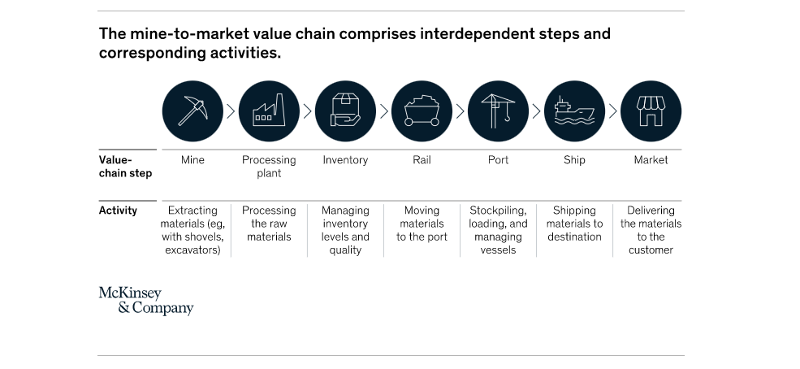
Securing end-to-end efficiency of complex mining value chains

Slide 19
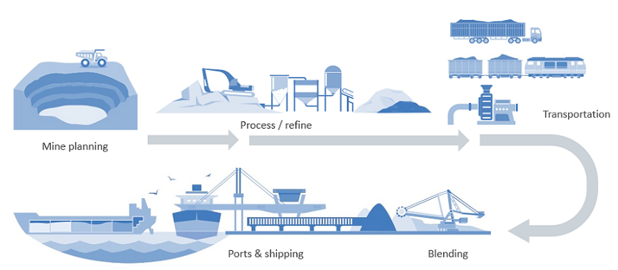
Mining is more than just mining methods

Slide 20
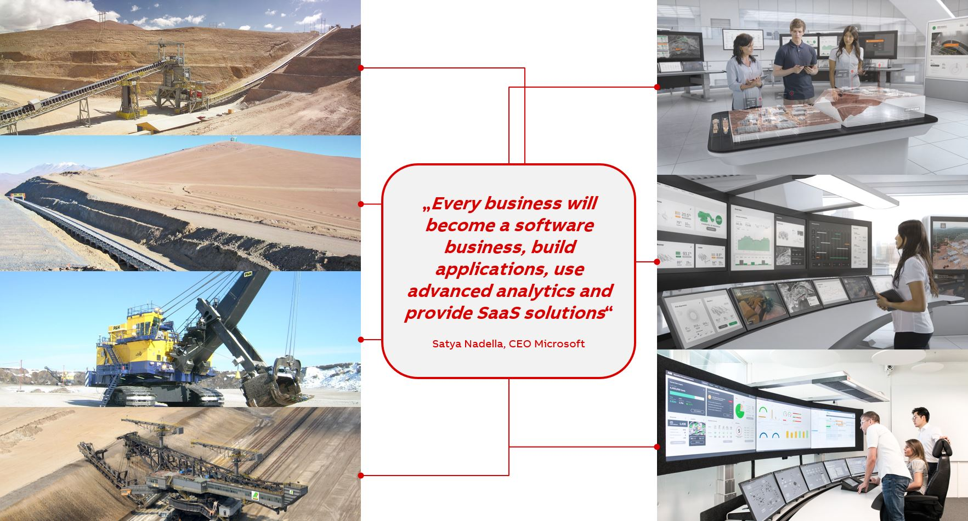
Ready or not, it's time to embrace data analytics

Slide 21
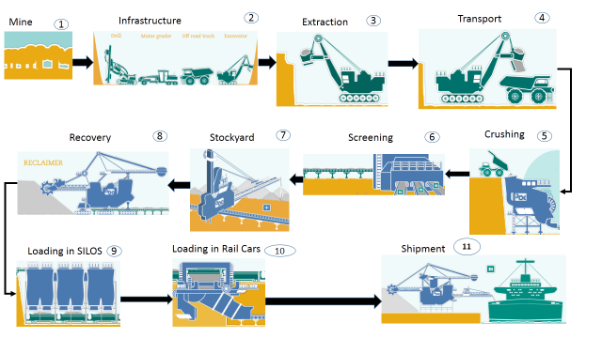
PIT to PORT Optimization

Slide 22
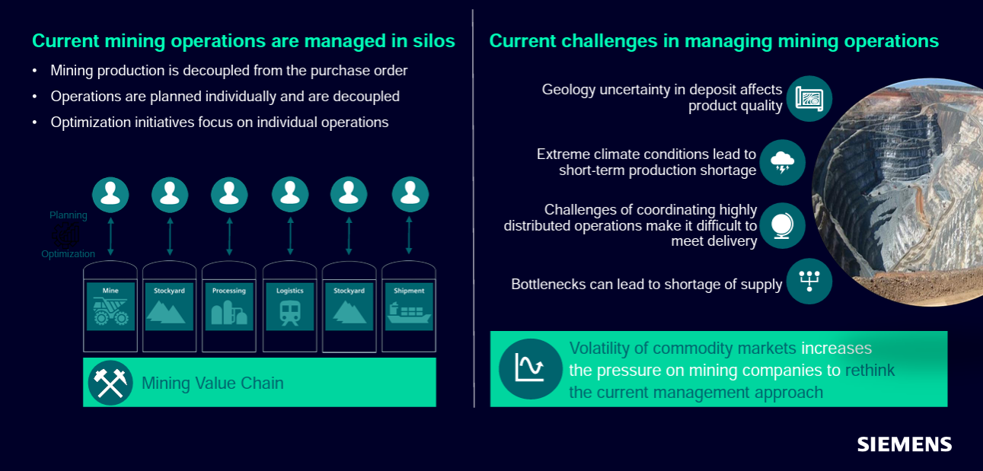
Integrating all mining operations

Slide 23
From extraction to the customer: The mine-to-market value chain
Raw material is extracted from both open-pit and underground mines with the help of specialized equipment. The material is then transported (typically on conveyors or trucks) to a processing plant, where it undergoes multiple steps to create a shippable product. These steps vary with the respective raw material—for example, ore processing consists of crushing and grinding. For bulk material (eg, iron ore) once reconditioned, the product is stacked in stockyards and then it is transported to the port. For product types that come in various grades of quality, such as iron ore, an additional step known as product blending takes place before the product is loaded onto the ship and transported to the customer.

Slide 24
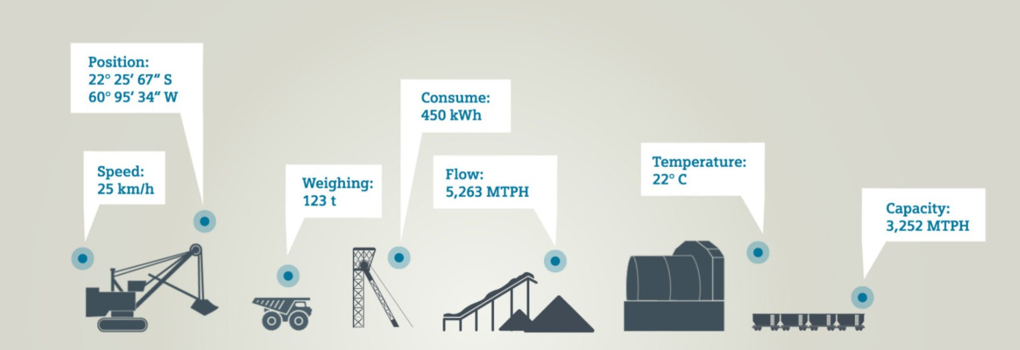
DIGITIZATION: Data Sources
Automation – seamless integration of information and comprehensive data collection for all plant levels available
Collecting data and storing for further analysis

Slide 25
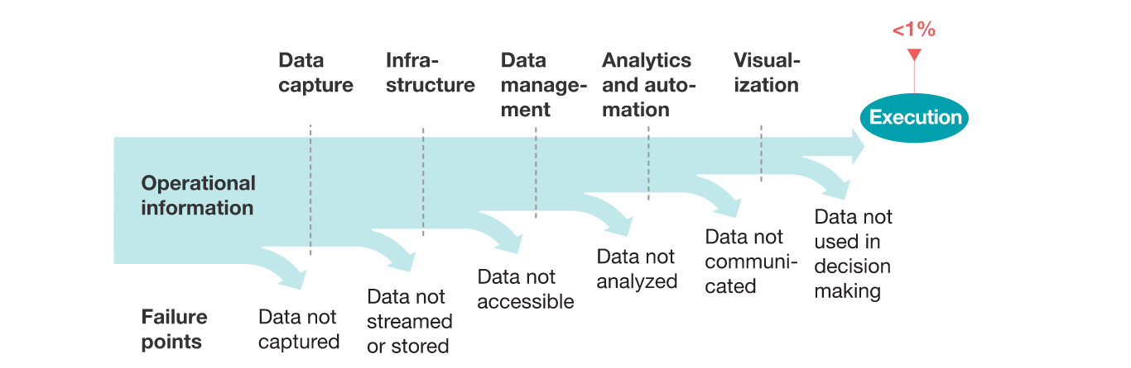
Mining companies typically collect huge amounts of data BUT NEVER USE IT (McKinsey)

Slide 26
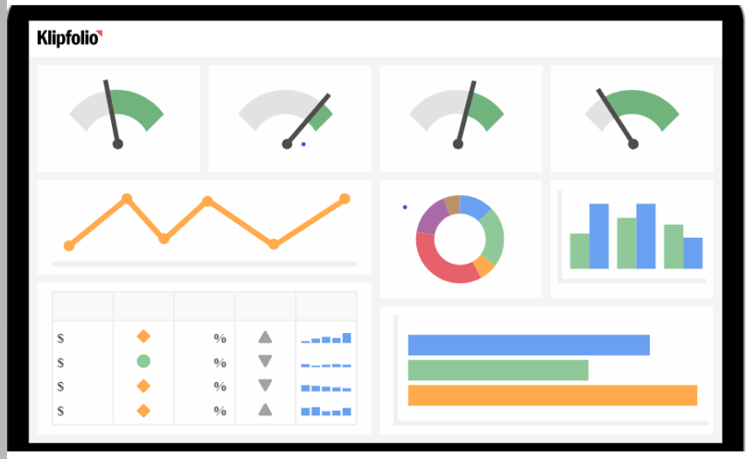

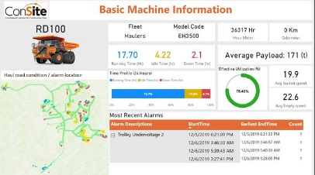

Data Generated, Captured, Stored, Visualized
CLOUD BASED DATA STORAGE
DATA VISULAIZATION through DASHBOARDS
IIoT
IIoT
IIoT
Digital solutions for the mining industry

Slide 27
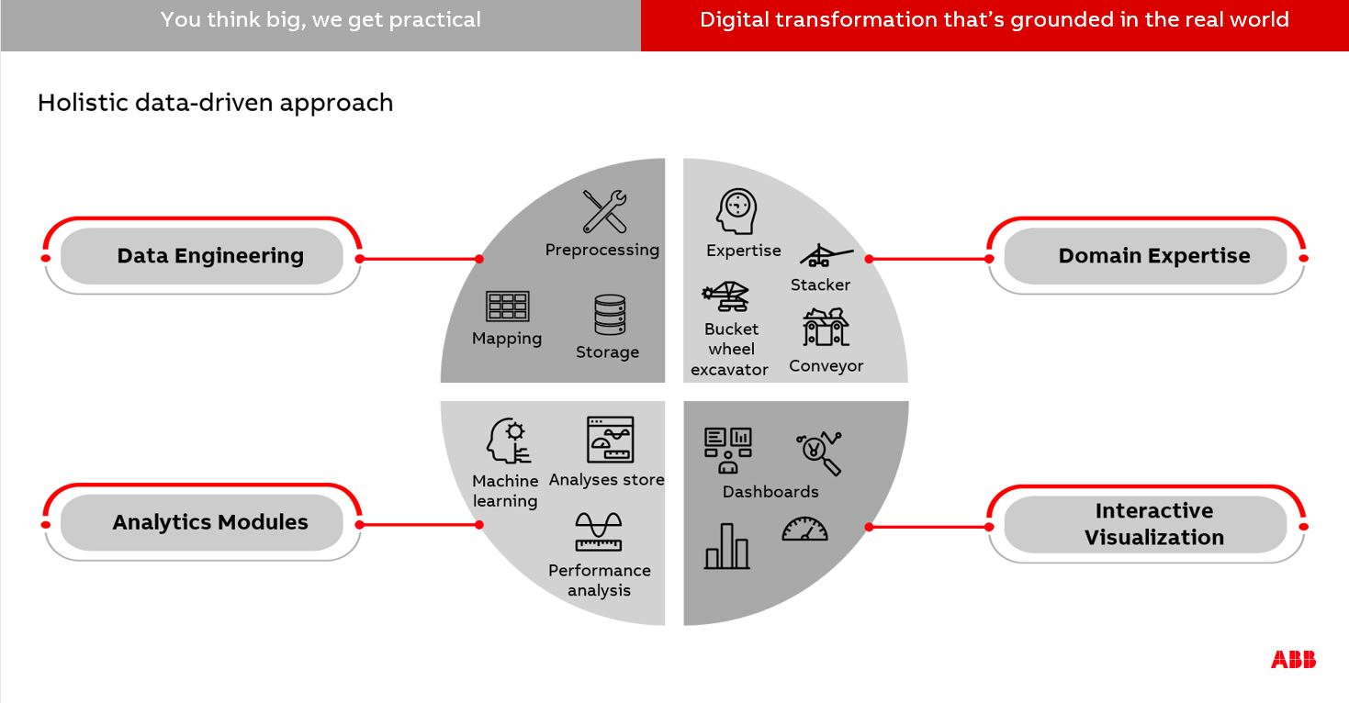
DIGITILIZATION AND DIGITIZATION

Slide 28
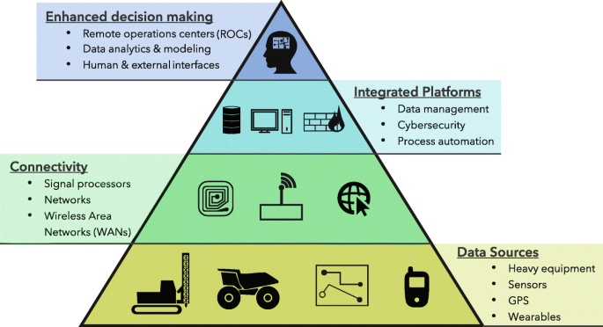

Slide 29
DIGITILIZATION
DIGILTILIZATION OF GHG EMISDSIONS IN A MINE
DIGITILIZATION OF WATER USAGE IN A MINE
DIGITILIZATION OF GRADE OF COAL IN A MINE

Slide 30
Mine optimization: improve productivity, reduce downtime, protect workforce and environment
Digital applications to optimize mining operations
Process and Power Control increases operator effectiveness by unmatched focus on situational awareness in order to avoid operation errors that cause loss of productivity
Advanced Process Control reduces energy consumption and increases productivity while maintaining the desired quality automatically, 24/7
Asset Management and Condition Monitoring minimize unplanned down time and increase equipment availability, while helping to optimize maintenance activities
Operation Management Systems create a new level of visibility in mining operations. They allow the operator to react in real time to any disturbance and assist planning with automatic scheduling. The result is a much higher utilization of the mobile fleet.
Production Information Management systems consolidate data on plant and enterprise level and provide insight information as well as KPIs in easy to understand dashboards and reports.

Slide 31
Things for US TO DO
There exist countless opportunities for Mining Engineers to apply Operations Research and Systems Engineering
From pit to port, whatever part of the mining process you’re involved in, come up with innovative and inspired solutions to meet your operational challenges.

Slide 32

Mining & Metals + Internet of Things: Industry opportunities and innovation

Slide 33
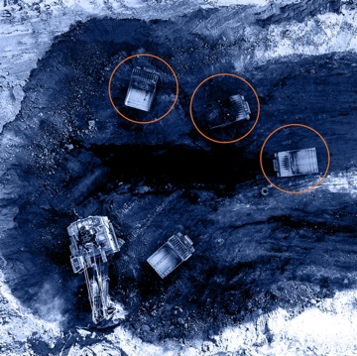
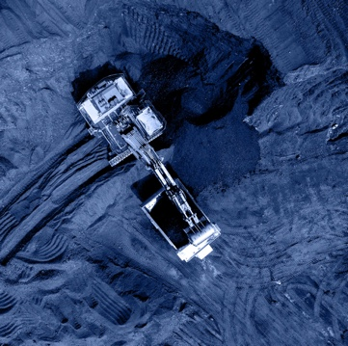
When it comes to fleet management, “optimization means ensuring that trucks arrive at shovels just in time to be loaded,
Without Optimization
With Optimization

Slide 34
OVERLOADING & UNDERLOADING OF RAKES- ECL Jhanjra UG COAL MINES
OVERLOADING of Railway Wagons for Coal Transportation
- Penalty Is paid to railway by consumer (ECL is transporting to NTPC)
1-3 Ton ( 2 times the cost of coal)
3-4 Ton ( 3 times the cost of coal)
4-5 Ton ( 4 times the cost of coal)
UNDERLOADING of Railway Wagons for Coal Transportation
Penalty Charge
Imposed by railway on shipper (mining company)
Amount equivalent to freight charges

Slide 35
MCL Lingraj Mines
Automated SILO Loading of Railway WAGONS through a hopper

Slide 36
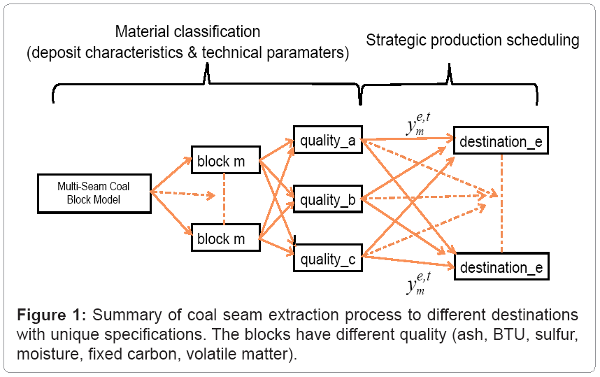
Stochastic Non-Linear Optimization of Equipment Productivity in Multi-Seam Formations

Slide 37
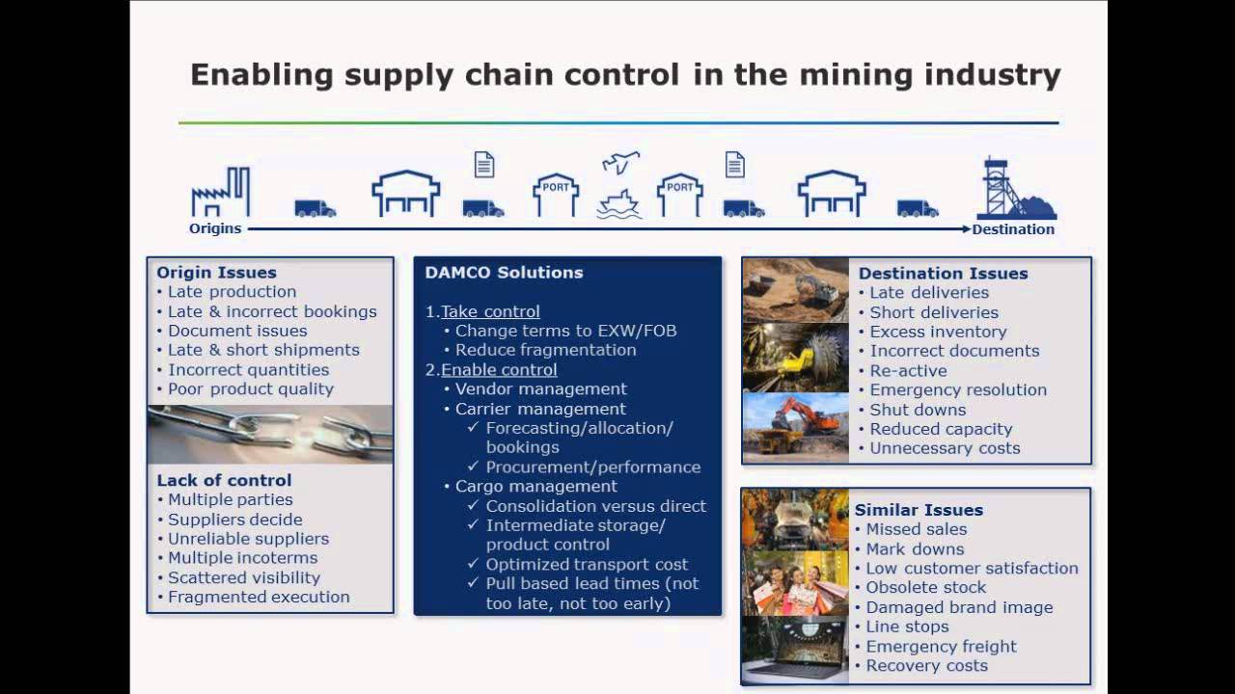

Slide 38
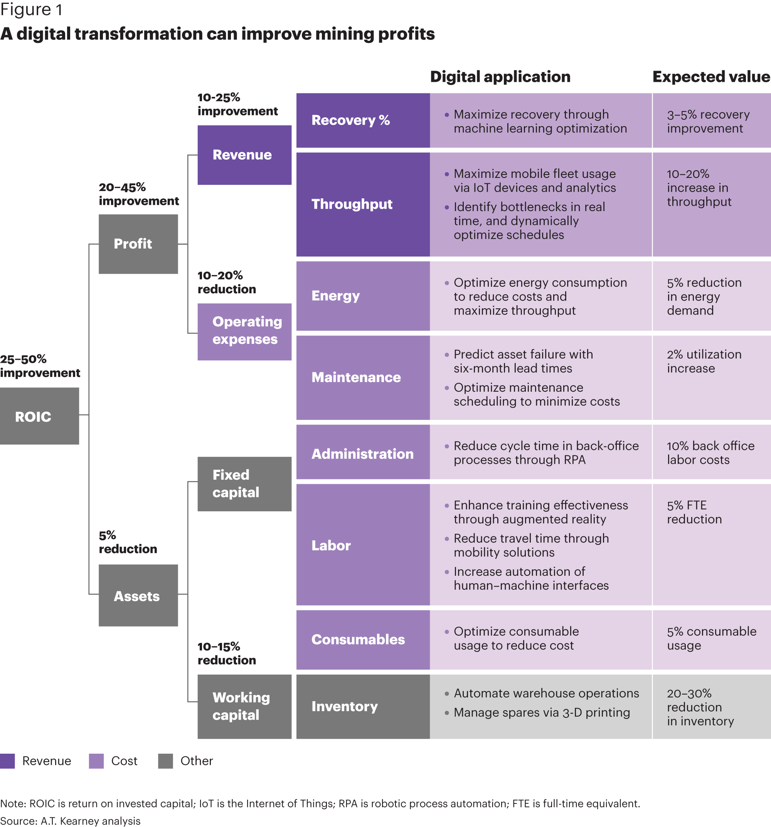
Digital technology fuels better, faster decision-making

Slide 39
Advantages
One set of advances have occurred in the comminution process – the series of mills that crush and then grind the ore until the particles are small enough to separate on the basis of their densities.
Other areas of progress include the increased efficiency of ventilation and the reliability of hoist systems. For example, smart ventilation concept wires airflow sensors data into adistributed control system. This can then optimize air quality throughout the mine and, as a result, halve the electricity needed to run its fans.
On the power supply and electrification side, the mining industry is looking for ways to reduce energy consumption, cut costs and pollution by transitioning from diesel to electricity.
Finally, the digitalization is creating additional value and visibility from mine to port and from plant to enterprise

Slide 40
Problem Solving and Decision Making
7 Steps of Problem Solving
(First 5 steps are the process of decision making)
Identify and define the problem.
Determine the set of alternative solutions.
Determine the criteria for evaluating the alternatives.
Evaluate the alternatives.
Choose an alternative.
---------------------------------------------------------------
Implement the chosen alternative.
Evaluate the results.

Slide 41
Quantitative Analysis and Decision Making
Potential Reasons for a Quantitative Analysis Approach to Decision Making
The problem is complex.
The problem is very important.
The problem is new.
The problem is repetitive.

Slide 42
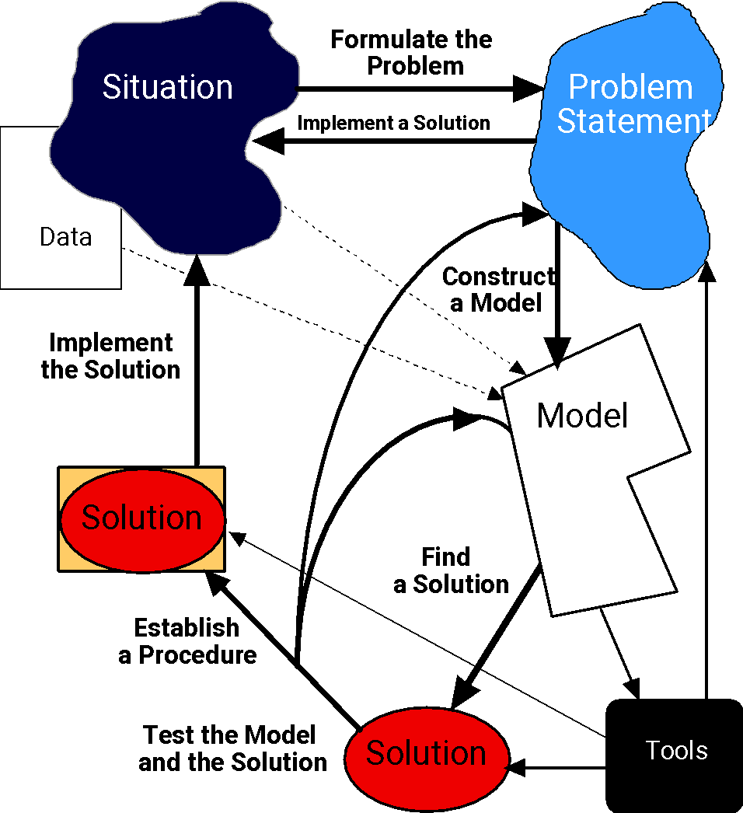
Problem Solving Process
Goal: solve a problem
Model must be valid
Model must be tractable
Solution must be useful

Slide 43

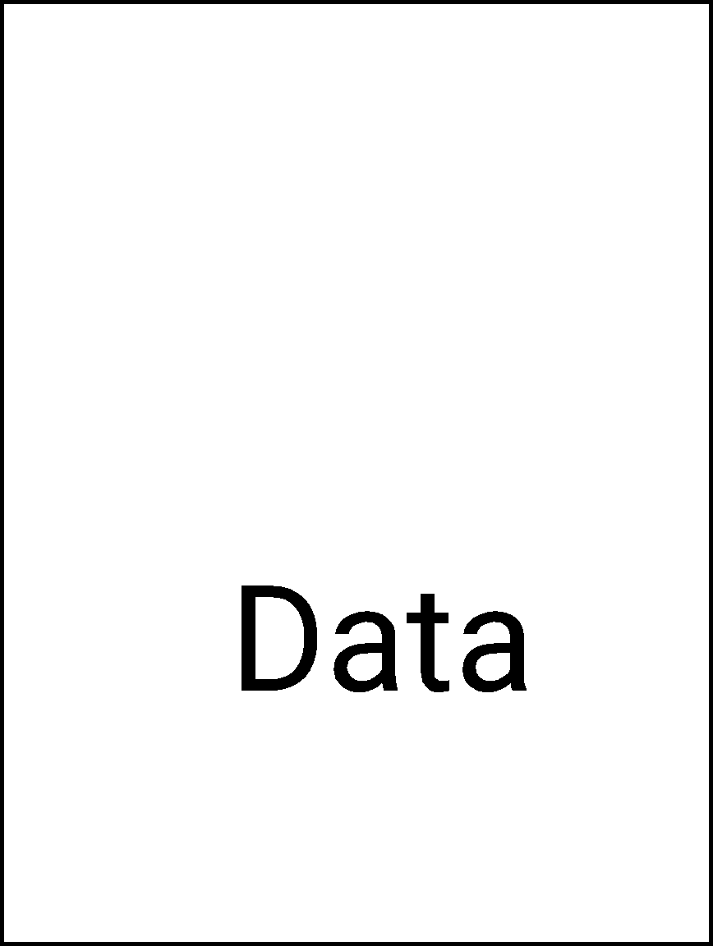
The Situation
May involve current operations or proposed expansions due to expected market shifts
May become apparent through consumer complaints or through employee suggestions
May be a conscious effort to improve efficiency or response to an unexpected crisis.
Example: Internal nursing staff not happy with their schedules; hospital using too many external nurses.

Slide 44
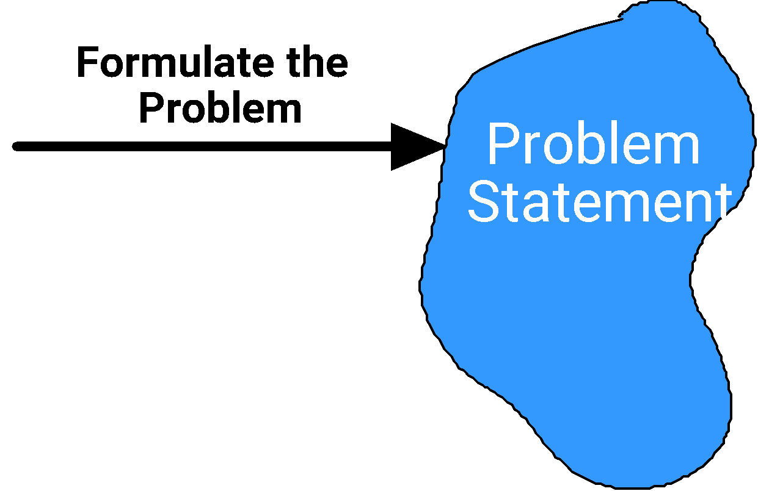
Problem Formulation
Describe system
Define boundaries
State assumptions
Select performance measures
Define variables
Define constraints
Data requirements
Example: Maximize individual nurse preferences subject to demand requirements.

Slide 45
Data Preparation
Data preparation is not a trivial step, due to the time required and the possibility of data collection errors.
A model with 50 decision variables and 25 constraints could have over 1300 data elements!
Often, a fairly large data base is needed.
Information systems specialists might be needed.

Slide 46


Constructing a Model
Problem
statement
Problem must be translated from verbal, qualitative terms to logical, quantitative terms
A logical model is a series of rules, usually embodied in a computer program
Formulate the
Problem
Construct
a Model
A mathematical model is a collection of functional relationships by which allowable actions are delimited and evaluated.
Model
Example: Define relationships between individual nurse assignments and preference violations; define tradeoffs between the use of internal and external nursing resources.

Slide 47
Model Development
Models are representations of real objects or situations.
Three forms of models are iconic, analog, and mathematical.
Iconic models are physical replicas (scalar representations) of real objects.
Analog models are physical in form, but do not physically resemble the object being modeled.
Mathematical models represent real world problems through a system of mathematical formulas and expressions based on key assumptions, estimates, or statistical analyses.

Slide 48
Advantages of Models
Generally, experimenting with models (compared to experimenting with the real situation):
requires less time
is less expensive
involves less risk

Slide 49
Mathematical Models
Cost/benefit considerations must be made in selecting an appropriate mathematical model.
Frequently a less complicated (and perhaps less precise) model is more appropriate than a more complex and accurate one due to cost and ease of solution considerations.

Slide 50
Mathematical Models
Relate decision variables (controllable inputs) with fixed or variable parameters (uncontrollable inputs).
Frequently seek to maximize or minimize some objective function subject to constraints.
Are said to be stochastic if any of the uncontrollable inputs (parameters) is subject to variation (random), otherwise are said to be deterministic.
Generally, stochastic models are more difficult to analyze.
The values of the decision variables that provide the mathematically-best output are referred to as the optimal solution for the model.

Slide 51
Transforming Model Inputs into Output
Uncontrollable Inputs
(Environmental Factors)
Controllable
Inputs
(Decision Variables)
Mathematical
Model
Output
(Projected Results)

Slide 52
Example: Project Scheduling
Consider a construction company building a 250-unit apartment complex. The project consists of hundreds of activities involving excavating, framing, wiring, plastering, painting, landscaping, and more. Some of the activities must be done sequentially and others can be done simultaneously. Also, some of the activities can be completed faster than normal by purchasing additional resources (workers, equipment, etc.).
What is the best schedule for the activities and for which activities should additional resources be purchased?

Slide 53
Example: Project Scheduling
Question:
Suggest assumptions that could be made to simplify the model.
Answer:
Make the model deterministic by assuming normal and expedited activity times are known with certainty and are constant. The same assumption might be made about the other stochastic, uncontrollable inputs.

Slide 54
Example: Project Scheduling
Question:
How could management science be used to solve this problem?
Answer:
Management science can provide a structured, quantitative approach for determining the minimum project completion time based on the activities' normal times and then based on the activities' expedited (reduced) times.

Slide 55
Example: Project Scheduling
Question:
What would be the uncontrollable inputs?
Answer:
Normal and expedited activity completion times
Activity expediting costs
Funds available for expediting
Precedence relationships of the activities

Slide 56
Example: Project Scheduling
Question:
What would be the decision variables of the mathematical model? The objective function? The constraints?
Answer:
Decision variables: which activities to expedite and by how much, and when to start each activity
Objective function: minimize project completion time
Constraints: do not violate any activity precedence relationships and do not expedite in excess of the funds available.

Slide 57
Example: Project Scheduling
Question:
Is the model deterministic or stochastic?
Answer:
Stochastic. Activity completion times, both normal and expedited, are uncertain and subject to variation. Activity expediting costs are uncertain. The number of activities and their precedence relationships might change before the project is completed due to a project design change.

Slide 58
Solving the Mathematical Model
Many tools are available as discussed before
Some lead to “optimal” solutions (deterministic Models)
Others only evaluate candidates 🡪 trial and error to find “best” course of action
Model
Find a
solution
Solution
Tools
Example: Read nurse profiles and demand requirements, apply algorithm, post-processes results to get monthly schedules.

Slide 59
Model Solution
Involves identifying the values of the decision variables that provide the “best” output for the model.
One approach is trial-and-error.
might not provide the best solution
inefficient (numerous calculations required)
Special solution procedures have been developed for specific mathematical models.
some small models/problems can be solved by hand calculations
most practical applications require using a computer

Slide 60
Computer Software
A variety of software packages are available for solving mathematical models, some are:
Spreadsheet packages such as Microsoft Excel
The Management Scientist (MS)
Quantitative system for business (QSB)
LINDO, LINGO
Quantitative models (QM)
Decision Science (DS)

Slide 61
Model Testing and Validation
Often, the goodness/accuracy of a model cannot be assessed until solutions are generated.
Small test problems having known, or at least expected, solutions can be used for model testing and validation.
If the model generates expected solutions:
use the model on the full-scale problem.
If inaccuracies or potential shortcomings inherent in the model are identified, take corrective action such as:
collection of more-accurate input data
modification of the model

Slide 62
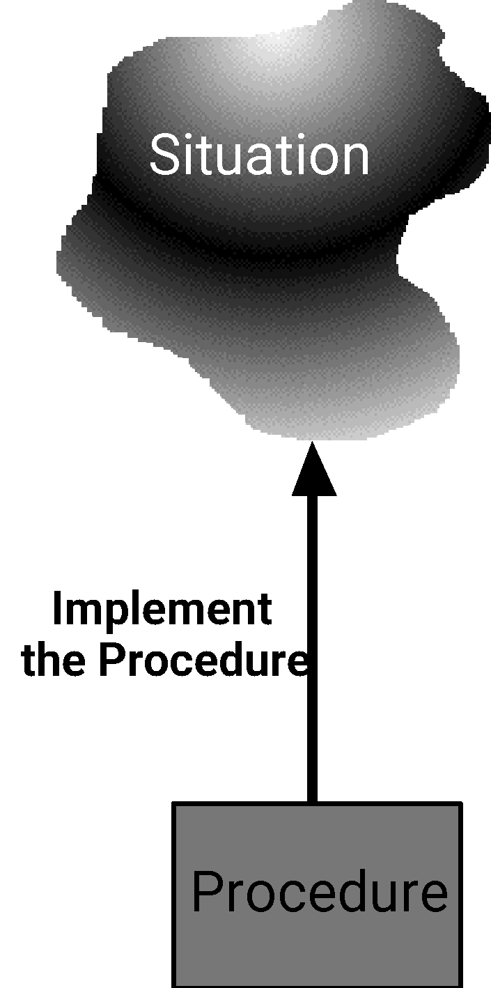
Implementation
A solution to a problem usually implies changes for some individuals in the organization
Often there is resistance to change, making the implementation difficult
User-friendly system needed
Those affected should go through training
Example: Implement nurse scheduling system in one unit at a time. Integrate with existing HR and T&A systems. Provide training sessions during the workday.

Slide 63
Implementation and Follow-Up
Successful implementation of model results is of critical importance.
Secure as much user involvement as possible throughout the modeling process.
Continue to monitor the contribution of the model.
It might be necessary to refine or expand the model.

Slide 64
Report Generation
A managerial report, based on the results of the model, should be prepared.
The report should be easily understood by the decision maker.
The report should include:
the recommended decision
other pertinent information about the results (for example, how sensitive the model solution is to the assumptions and data used in the model)

Slide 65

Components of OR-Based Decision Support System
Data base (nurse profiles, external resources, rules)
Graphical User Interface (GUI); web enabled using java or VBA
Algorithms, pre- and post- processor
What-if analysis
Report generators

Slide 66
Examples of OR Applications
Rescheduling aircraft in response to groundings and delays
Planning production for printed circuit board assembly
Scheduling equipment operators in mail processing & distribution centers
Developing routes for propane delivery
Adjusting nurse schedules in light of daily fluctuations in demand

Slide 67
Example: Austin Auto Auction
An auctioneer has developed a simple mathematical model for deciding the starting bid he will require when auctioning a used automobile. Essentially, he sets the starting bid at seventy percent of what he predicts the final winning bid will (or should) be. He predicts the winning bid by starting with the car's original selling price and making two deductions, one based on the car's age and the other based on the car's mileage.
The age deduction is $800 per year and the mileage deduction is $.025 per mile.

Slide 68
Example: Austin Auto Auction
Question:
Develop the mathematical model that will give the starting bid (B) for a car in terms of the car's original price (P), current age (A) and mileage (M).
Answer:
The expected winning bid can be expressed as:
P - 800(A) - .025(M)
The entire model is:
B = .7(expected winning bid) or
B = .7(P - 800(A) - .025(M)) or
B = .7(P)- 560(A) - .0175(M)

Slide 69
Example: Austin Auto Auction
Question:
Suppose a four-year old car with 60,000 miles on the odometer is up for auction. If its original price was $12,500, what starting bid should the auctioneer require?
Answer:
B = .7(12,500) - 560(4) - .0175(60,000) = $5460.

Slide 70
Example: Austin Auto Auction
Question:
The model is based on what assumptions?
Answer:
The model assumes that the only factors influencing the value of a used car are the original price, age, and mileage (not condition, rarity, or other factors).
Also, it is assumed that age and mileage devalue a car in a linear manner and without limit. (Note, the starting bid for a very old car might be negative!)

Slide 71
Example: Iron Works, Inc.
Iron Works, Inc. (IWI) manufactures two products made from steel and just received this month's allocation of b pounds of steel. It takes a₁ pounds of steel to make a unit of product 1 and it takes a₂ pounds of steel to make a unit of product 2.
Let x₁ and x₂ denote this month's production level of product 1 and product 2, respectively. Denote by p₁ and p₂ the unit profits for products 1 and 2, respectively.
The manufacturer has a contract calling for at least m units of product 1 this month. The firm's facilities are such that at most u units of product 2 may be produced monthly.

Slide 72
Example: Iron Works, Inc.
Mathematical Model
The total monthly profit =
(profit per unit of product 1)
x (monthly production of product 1)
+ (profit per unit of product 2)
x (monthly production of product 2)
= p₁x₁ + p₂x₂
We want to maximize total monthly profit:
Max p₁x₁ + p₂x₂

Slide 73
Example: Iron Works, Inc.
Mathematical Model (continued)
The total amount of steel used during monthly production =
(steel required per unit of product 1)
x (monthly production of product 1)
+ (steel required per unit of product 2)
x (monthly production of product 2)
= a₁x₁ + a₂x₂
This quantity must be less than or equal to the allocated b pounds of steel:
a₁x₁ + a₂x₂ < b

Slide 74
Example: Iron Works, Inc.
Mathematical Model (continued)
The monthly production level of product 1 must be greater than or equal to m:
x₁ > m
The monthly production level of product 2 must be less than or equal to u:
x₂ < u
However, the production level for product 2 cannot be negative:
x₂ > 0

Slide 75
Example: Iron Works, Inc.
Mathematical Model Summary
Max p₁x₁ + p₂x₂
s.t. a₁x₁ + a₂x₂ < b
x₁ > m
x₂ < u
x₂ > 0

Slide 76
Example: Iron Works, Inc.
Question:
Suppose b = 2000, a₁ = 2, a₂ = 3, m = 60, u = 720, p₁ = 100, p₂ = 200. Rewrite the model with these specific values for the uncontrollable inputs.
Answer:
Substituting, the model is:
Max 100x₁ + 200x₂
s.t. 2x₁ + 3x₂ < 2000
x₁ > 60
x₂ < 720
x₂ > 0

Slide 77
Example: Iron Works, Inc.
Question:
The optimal solution to the current model is x₁ = 60 and x₂ = 626 2/3. If the product were engines, explain why this is not a true optimal solution for the "real-life" problem.
Answer:
One cannot produce and sell 2/3 of an engine. Thus the problem is further restricted by the fact that both x₁ and x₂ must be integers. They could remain fractions if it is assumed these fractions are work in progress to be completed the next month.

Slide 78
Example: Iron Works, Inc.
Uncontrollable Inputs
$100 profit per unit Prod. 1
$200 profit per unit Prod. 2
2 lbs. steel per unit Prod. 1
3 lbs. Steel per unit Prod. 2
2000 lbs. steel allocated
60 units minimum Prod. 1
720 units maximum Prod. 2
0 units minimum Prod. 2
60 units Prod. 1
626.67 units Prod. 2
Max 100(60) + 200(626.67)
s.t. 2(60) + 3(626.67) < 2000
60 > 60
626.67 < 720
626.67 > 0
Profit = $131,333.33
Steel Used = 2000
Controllable Inputs
Output
Mathematical Model

Slide 79
Example: Ponderosa Development Corp.
Ponderosa Development Corporation (PDC) is a small real estate developer operating in the Rivertree Valley. It has seven permanent employees whose monthly salaries are given in the table on the next slide.
PDC leases a building for $2,000 per month. The cost of supplies, utilities, and leased equipment runs another $3,000 per month.
PDC builds only one style house in the valley. Land for each house costs $55,000 and lumber, supplies, etc. run another $28,000 per house. Total labor costs are figured at $20,000 per house. The one sales representative of PDC is paid a commission of $2,000 on the sale of each house. The selling price of the house is $115,000.

Slide 80
Example: Ponderosa Development Corp.
Employee Monthly Salary
President $10,000
VP, Development 6,000
VP, Marketing 4,500
Project Manager 5,500
Controller 4,000
Office Manager 3,000
Receptionist 2,000

Slide 81
Example: Ponderosa Development Corp.
Question:
Identify all costs and denote the marginal cost and marginal revenue for each house.
Answer:
The monthly salaries total $35,000 and monthly office lease and supply costs total another $5,000. This $40,000 is a monthly fixed cost.
The total cost of land, material, labor, and sales commission per house, $105,000, is the marginal cost for a house.
The selling price of $115,000 is the marginal revenue per house.

Slide 82
Example: Ponderosa Development Corp.
Question:
Write the monthly cost function c(x), revenue function r(x), and profit function p(x).
Answer:
c(x) = variable cost + fixed cost = 105,000x + 40,000
r(x) = 115,000x
p(x) = r(x) - c(x) = 10,000x - 40,000

Slide 83
Example: Ponderosa Development Corp.
Question:
What is the breakeven point for monthly sales of the houses?
Answer:
r(x) = c(x) or 115,000x = 105,000x + 40,000
Solving, x = 4.
Question:
What is the monthly profit if 12 houses per month are built and sold?
Answer:
p(12) = 10,000(12) - 40,000 = $80,000 monthly profit

Slide 84
Example: Ponderosa Development Corp.
Graph of Break-Even Analysis
1200
1000
Total Revenue = 115,000x
Total Cost =
40,000 + 105,000x
800
Thousands of Dollars
600
Break-Even Point = 4 Houses
400
200
0
0
1
2
3
4
5
6
7
8
9
10
Number of Houses Sold (x)

Slide 85
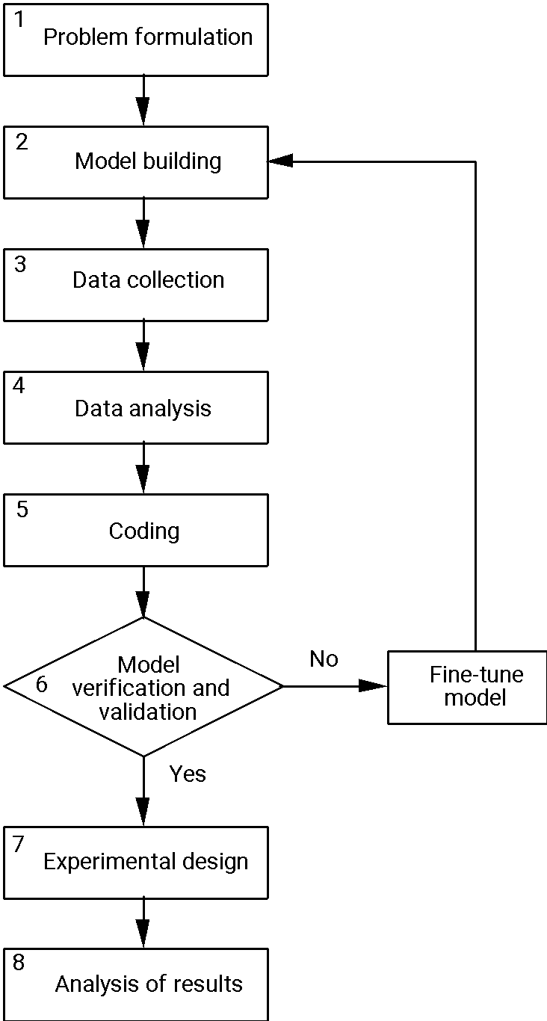
Steps in OR Study

Slide 86
Success Stories of OR

Slide 87
Application Areas
Strategic planning
Supply chain management
Pricing and revenue management
Logistics and site location
Optimization
Marketing research

Slide 88
Applications Areas (cont.)
Scheduling
Portfolio management
Inventory analysis
Forecasting
Sales analysis
Auctioning
Risk analysis

Slide 89
Examples
British Telecom used OR to schedule workforce for more than 40,000filed engineers. The system was saving $150 million a year from 1997~ 2000. The workforce is projected to save $250 million.
Sears Uses OR to create a Vehicle Routing and Scheduling System which to run its delivery and home service fleet more efficiently -- $42 million in annual savings
UPS use O.R. to redesign its overnight delivery network, $87 million in savings obtained from 2000 ~ 2002; Another $189 million anticipated over the following decade.
USPS uses OR to schedule the equipment and workforce in its mail processing and distribution centers. Estimated saving in $500 millions can be achieve.

Slide 90
A Short List of Successful Stories (1)
Air New Zealand
Air New Zealand Masters the Art of Crew Scheduling
AT&T Network
Delivering Rapid Restoration Capacity for the AT&T Network
Bank Hapoalim
Bank Hapoalim Offers Investment Decision Support for Individual Customers
British Telecommunications
Dynamic Workforce Scheduling for British Telecommunications
Canadian Pacific Railway
Perfecting the Scheduled Railroad at Canadian Pacific Railway
Continental Airlines
Faster Crew Recovery at Continental Airlines
FAA
Collaborative Decision Making Improves the FAA Ground-Delay Program

Slide 91
A Short List of Successful Stories (2)
Ford Motor Company
Optimizing Prototype Vehicle Testing at Ford Motor Company
General Motors
Creating a New Business Model for OnStar at General Motors
IBM Microelectronics
Matching Assets to Supply Chain Demand at IBM Microelectronics
IBM Personal Systems Group
Extending Enterprise Supply Chain Management at IBM Personal Systems Group
Jan de Wit Company
Optimizing Production Planning and Trade at Jan de Wit Company
Jeppesen Sanderson
Improving Performance and Flexibility at Jeppesen Sanderson

Slide 92
A Short List of Successful Stories (3)
Mars
Online Procurement Auctions Benefit Mars and Its Suppliers
Menlo Worldwide Forwarding
Turning Network Routing into Advantage for Menlo Forwarding
Merrill Lynch
Seizing Marketplace Initiative with Merrill Lynch Integrated Choice
NBC
Increasing Advertising Revenues and Productivity at NBC
PSA Peugeot Citroen
Speeding Car Body Production at PSA Peugeot Citroen
Rhenania
Rhenania Optimizes Its Mail-Order Business with Dynamic Multilevel Modeling
Samsung
Samsung Cuts Manufacturing Cycle Time and Inventory to Compete

Slide 93
A Short List of Successful Stories (4)
Spicer
Spicer Improves Its Lead-Time and Scheduling Performance
Syngenta
Managing the Seed-Corn Supply Chain at Syngenta
Towers Perrin
Towers Perrin Improves Investment Decision Making
U.S. Army
Reinventing U.S. Army Recruiting
U.S. Department of Energy
Handling Nuclear Weapons for the U.S. Department of Energy
UPS
More Efficient Planning and Delivery at UPS
Visteon
Decision Support Wins Visteon More Production for Less

Slide 94
Finale
Please Go to
www.scienceofbetter.org
For details on these successful stories

Slide 95
Case 1: Continental Airlines Survives 9/11
Problem: Long before September 11, 2001, Continental asked what crises plan it could use to plan recovery from potential disasters such as limited and massive weather delays.

Slide 96
Continental Airlines (con’t)
Strategic Objectives and Requirements are to accommodate:
1,400 daily flights
5,000 pilots
9,000 flight attendants
FAA regulations
Union contracts

Slide 97
Continental Airlines (con’t)
Model Structure: Working with CALEB Technologies, Continental used an optimization model to generate optimal assignments of pilots & crews. The solution offers a system-wide view of the disrupted flight schedule and all available crew information.

Slide 98
Continental Airlines (con’t)
Project Value: Millions of dollars and thousands of hours saved for the airline and its passengers. After 9/11, Continental was the first airline to resume normal operations.

Slide 99
Case 2: Merrill Lynch Integrated Choice
Problem: How should Merrill Lynch deal with online investment firms without alienating financial advisors, undervaluing its services, or incurring substantial revenue risk?

Slide 100
Merrill Lynch (con’t)
Objectives and Requirements: Evaluate new products and pricing options, and options of online vs. traditional advisor-based services.

Slide 101
Merrill Lynch (con’t)
Model Structure: Merrill Lynch’s Management Science Group simulated client-choice behavior, allowing it to:
Evaluate the total revenue at risk
Assess the impact of various pricing schedules
Analyze the bottom-line impact of introducing different online and offline investment choices

Slide 102
Merrill Lynch (con’t)
Project Value:
Introduced two new products which garnered $83 billion ($22 billion in new assets) and produced $80 million in incremental revenue
Helped management identify and mitigate revenue risk of as much as $1 billion
Reassured financial advisors

Slide 103
Case 3: NBC’s Optimization of Ad Sales
Problem: NBC sales staff had to manually develop sales plans for advertisers, a long and laborious process to balance the needs of NBC and its clients. The company also sought to improve the pricing of its ad slots as a way of boosting revenue.

Slide 104
NBC Ad Sales (con’t)
Strategic Objectives and Requirements: Complete intricate sales plans while reducing labor cost and maximizing income.

Slide 105
NBC Ad Sales (con’t)
Model Structure: NBC used optimization models to reduce labor time and revenue management to improve pricing of its ad spots, which were viewed as a perishable commodity.

Slide 106
NBC Ad Sales (con’t)
Project Value: In its first four years, the systems increased revenues by over $200 million, improved sales-force productivity, and improved customer satisfaction.

Slide 107
Case 4: Ford Motor Prototype Vehicle Testing
Problem: Developing prototypes for new cars and modified products is enormously expensive. Ford sought to reduce costs on these unique, first-of-a-kind creations.

Slide 108
Ford Motor (con’t)
Strategic Objectives and Requirements: Ford needs to verify the designs of its vehicles and perform all necessary tests. Historically, prototypes sit idle much of the time waiting for various tests, so increasing their usage would have a clear benefit.

Slide 109
Ford Motor (con’t)
Model Structure: Ford and a team from Wayne State University developed a Prototype Optimization Model (POM) to reduce the number of prototype vehicles. The model determines an optimal set of vehicles that can be shared and used to satisfy all testing needs.

Slide 110
Ford Motor (con’t)
Project Value: Ford reduced annual prototype costs by $250 million.

Slide 111
Case 5: Procter & Gamble Supply Chain
Problem: To ensure smart growth, P&G needed to improve its supply chain, streamline work processes, drive out non-value-added costs, and eliminate duplication.

Slide 112
P&G Supply Chain (con’t)
Strategic Objectives and Requirements: P&G recognized that there were potentially millions of feasible options for its 30 product-strategy teams to consider. Executives needed sound analytical support to realize P&G’s goal within the tight, one-year objective.

Slide 113
P&G Supply Chain (con’t)
Model Structure: The P&G operations research department and the University of Cincinnati created decision-making models and software. They followed a modeling strategy of solving two easier-to-handle subproblems:
Distribution/location
Product sourcing

Slide 114
P&G Supply Chain (con’t)
Project Value: The overall Strengthening Global Effectiveness (SGE) effort saved $200 million a year before tax and allowed P&G to write off $1 billion of assets and transition costs.

Slide 115
Case 6: American Airlines Revolutionizes Pricing
Business Problem: To compete effectively in a fierce market, the company needed to “sell the right seats to the right customers at the right prices.”

Slide 116
American Airlines (con’t)
Strategic Objectives and Requirements: Airline seats are a perishable commodity. Their value varies – at times of scarcity they’re worth a premium, after the flight departs, they’re worthless. The new system had to develop an approach to pricing while creating software that could accommodate millions of bookings, cancellations, and corrections.

Slide 117
American Airlines (con’t)
Model Structure: The team developed yield management, also known as revenue management and dynamic pricing. The model broke down the problem into three subproblems:
Overbooking
Discount allocation
Traffic management
The model was adapted to American Airlines computers.

Slide 118
American Airlines (con’t)
Project Value: In 1991, American Airlines estimated a benefit of $1.4 billion over the previous three years. Since then, yield management was adopted by other airlines, and spread to hotels, car rentals, and cruises, resulting in added profits going into billions of dollars.

Slide 119
What you Should Know about Operations Research
How decision-making problems are characterized
OR terminology
What a model is and how to assess its value
How to go from a conceptual problem to a quantitative solution

Slide 120
